Slide 1
ATT Auto Parts
Alican Özer - Thang Mai – Tam Tan
Notes:
http://svnaws.chalosoft.com/home
http://att.cuidot.vn

Slide 2
Agenda
Overview
Solution
System architecture
Demo
Q/A

Slide 3

Overview - ATT Auto Parts
The need:
A website to sell auto parts
Scalable
Better performance
Centralized in AWS
Features:
Product List
Product Details
Support Users register & Login
Buy products and checkout

Slide 4







Solution
End-to-end solution:
Analyze - Design – Code – Test - Deliver
Using Kanban
Resources:
3 head count
Management & Communication Tools
Github
Email
Fb messenger
The technologies used:

Slide 5
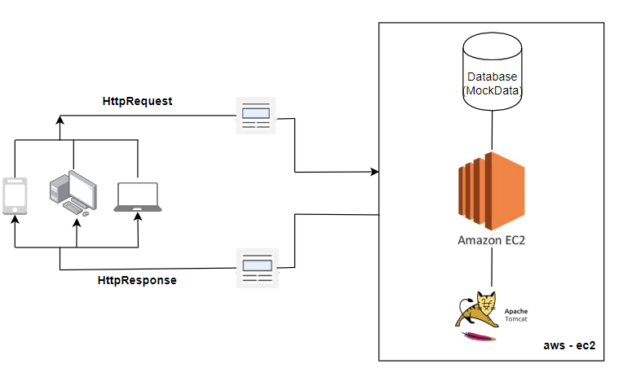
System Architecture

Slide 6
WORK BREAK-DOWN STRUCTURE
No | Task | Assignee | Status
1 | Init Maven project, setup repository | Thang Mai | Done
2 | Develop page to show product list | Thang Mai | Done
3 | Develop product details page | Thang Mai | Done
4 | Define data model | Tam Tan | Done
5 | Define database (mock) | Thang Mai | Done
6 | Define data access layer | Alican | Done
7 | Login | Tam Tan | Done
8 | Register | Tam Tan | Done
9 | Logout | Thang Mai | Done
10 | User Profile | Tam Tan | Done
11 | Develop add to cart function | Alican | Done
12 | Develop shopping cart page | Alican | Done
13 | Integrate add to cart feature into product list page | Alican | Done
14 | Integrate add to cart feature into product details page | Alican | Done
15 | Integrate add to cart feature into shopping cart page | Alican | Done
16 | Develop checkout page | Alican | Done
17 | Setup EC2 on AWS | Thang Mai | Done
18 | Setup domain | Thang Mai | Done
19 | Deploy project to EC2 | Thang Mai | Done
20 | Create presentation file | Thang Mai, Alican, Tam Tan | Done

Slide 7
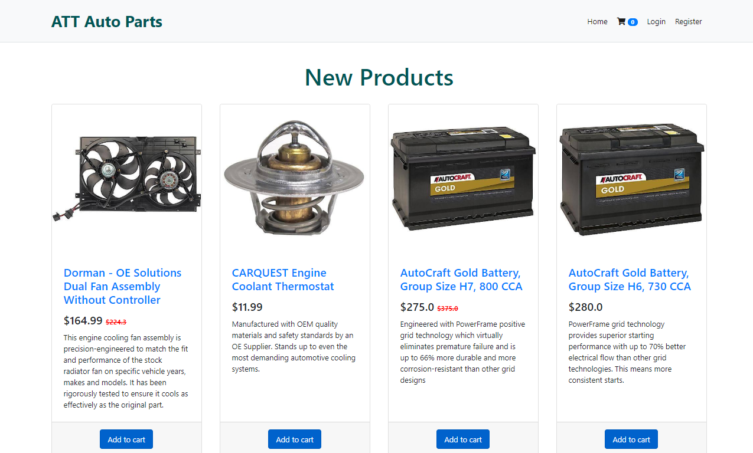
Screenshots

Slide 8
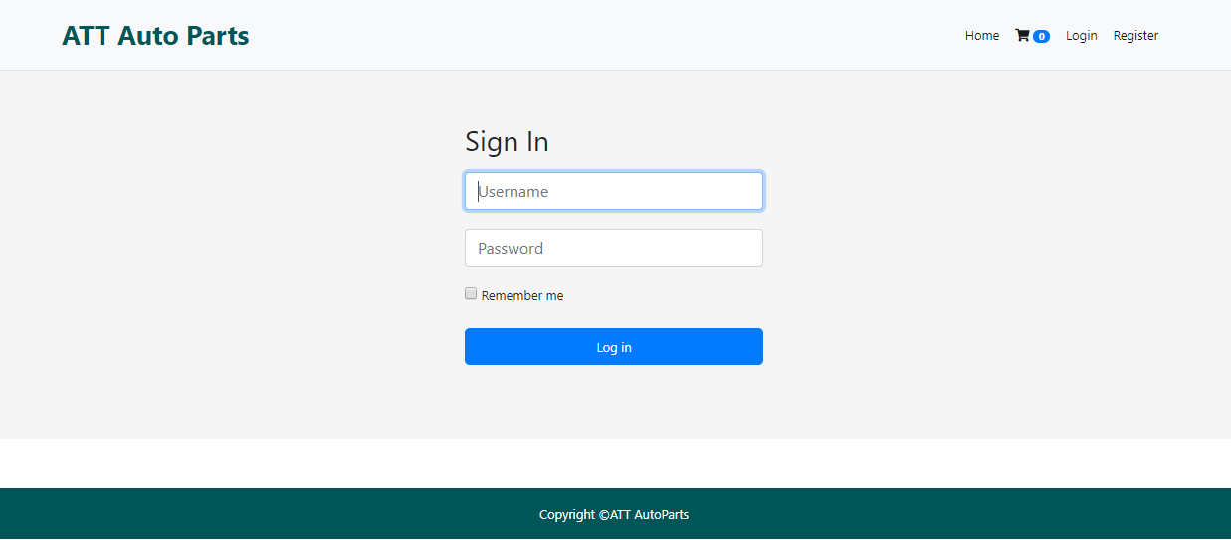
Screenshots

Slide 9
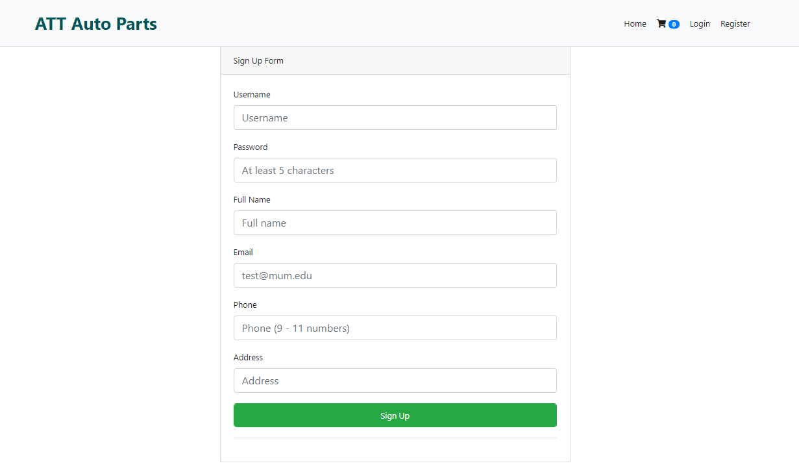
Screenshots

Slide 10
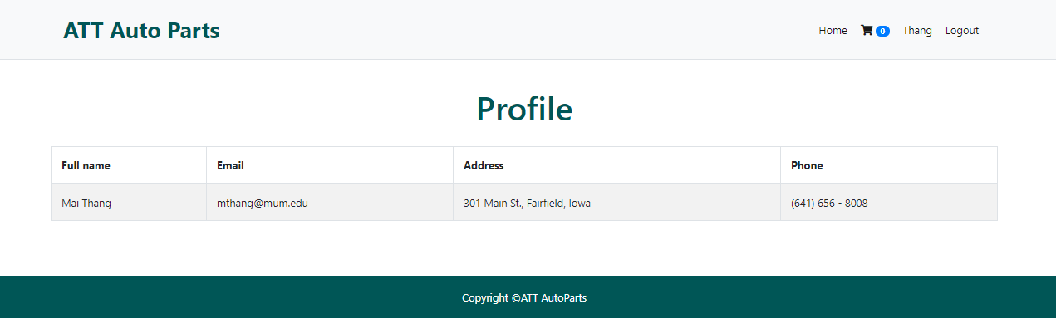
Screenshots

Slide 11
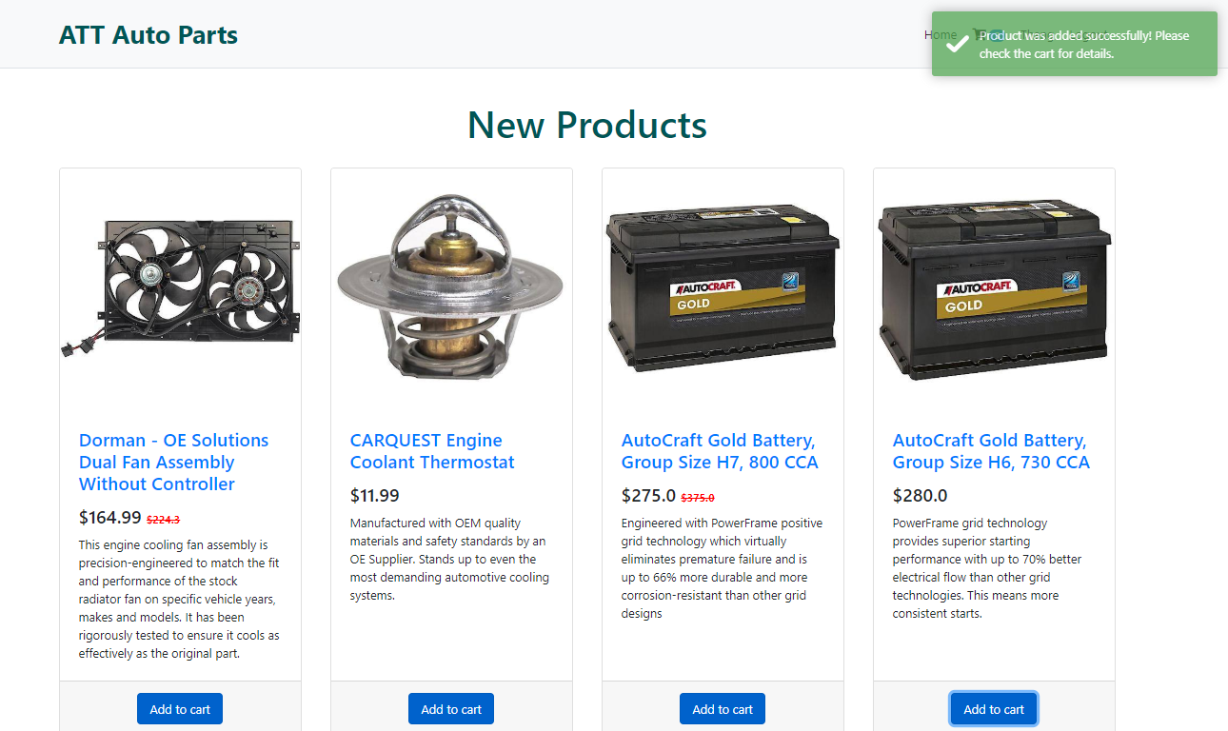
Screenshots

Slide 12
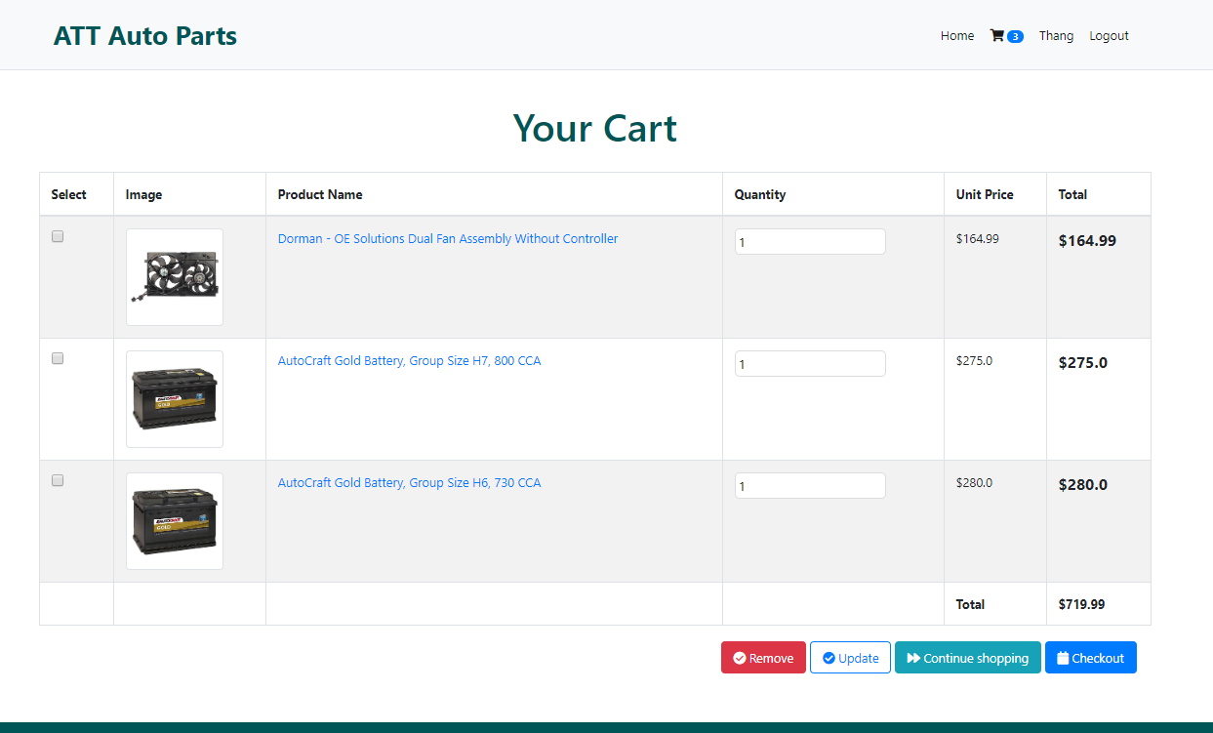
Screenshots

Slide 13
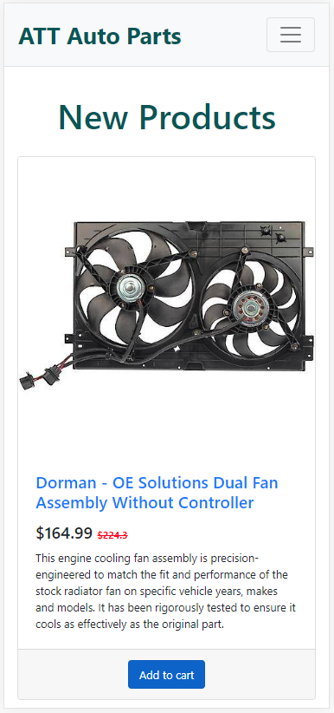
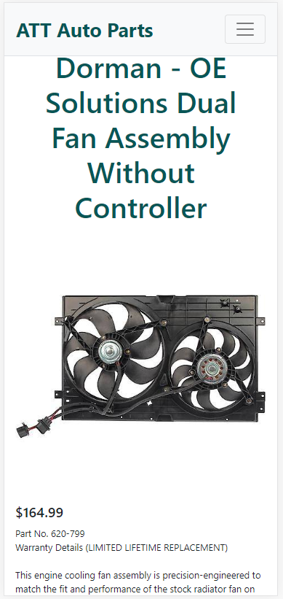
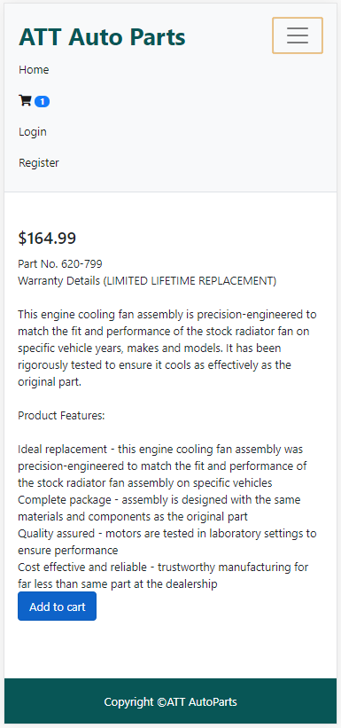
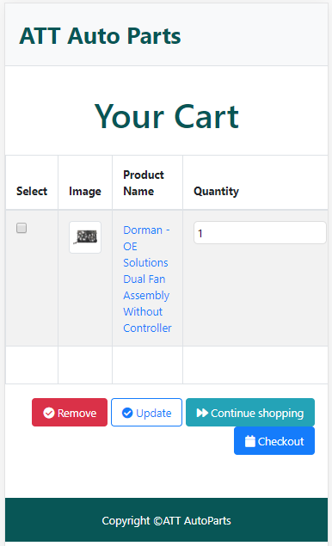
Screenshots – Mobile View

Slide 14
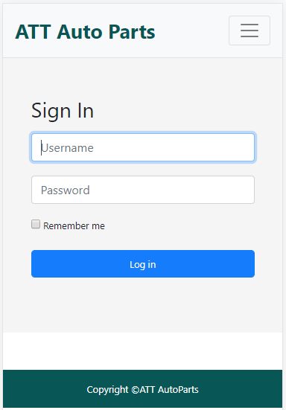
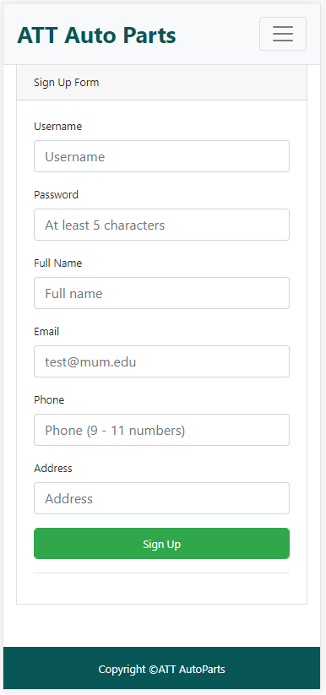
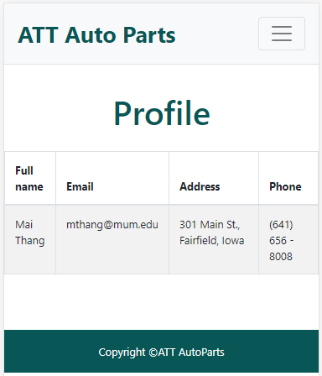
Screenshots – Mobile View

Slide 15


